Slide 1
Variables
Notes:
Hi, in this video we’re going to learn how variables can be used to store values and execute our code with specific data.

Slide 2
What is a Variable?
Variables allow us to store information (text or numbers) that can be used and altered in our code.
We can use variables to control many parts of our code, from the distance we move Tracy to the color of Tracy’s trail!
Notes:
Variables give us the ability to store information that we can use in our code. This information can be text or numbers and can be altered as our code progresses.
Variables can be used to control different Tracy commands, such as how far she moves or what color her trail is.

Slide 3
Defining a Variable
variable_name = value
Variable Name: my_variable
Notes:
Before you use a variable, you need to give it a name and assign it a value.
(Click for label and red X) Don’t forget about our naming rules!

Slide 4
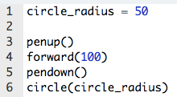
Assigning and Using Variables
Assign variable
Variables must always be defined before they are used!
Use variable
Notes:
To use a variable, the first thing (Click for yellow arrow) we need to do is assign it. We do this by writing the variable’s name followed by an equal sign and then the value we want to assign it.
(Click for blue arrow) To use the variable, we plug its name wherever we want to use its value. In this case, we want the value of the circle_radius variable, which is 50, to control the radius of our circle, so we plug it into our command where we would normally write the radius value.
(Click for label) It is very important to remember that we cannot use a variable unless we have previously defined it.

Slide 5
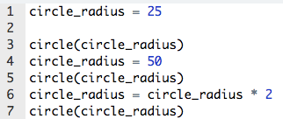
Changing a Variable’s Value
Value of circle_radius: 25
Define variable
Use variable
Change variable
Notes:
Once we create a variable, we can change it’s value throughout our code as much as we’d like! Everytime we give a variable a new value, we are overriding the value it had before. Each variable can only hold one value at a time.
At the beginning of this code, we created a variable called circle_radius and set its value to 25. So when we (Click for blue arrow) use the variable in line 3 to draw a circle, it will have a radius of 25.
After we’ve drawn this circle, (Click for red arrow) we are changing the value of the circle_radius variable to 50 on line 4.

Slide 6
Changing a Variable’s Value
Value of circle_radius: 50
Define variable
Use variable
Change variable
Use variable
Change variable
Notes:
So when we (Click for blue arrow) use this variable to draw another circle on line 5, it will now have a radius of 50.
On line 6, (Click for red arrow) we are using an equation to change the value of our variable. We are taking the previous value of the variable, which is 50, and multiplying it by 2...

Slide 7
Changing a Variable’s Value
Value of circle_radius: 100
Define variable
Use variable
Change variable
Use variable
Change variable
Use variable
Notes:
...so our variable now has a value of 100.
(Click for blue arrow) When we use our variable for the last time on line 7, our circle will have a radius of 100.

Slide 8
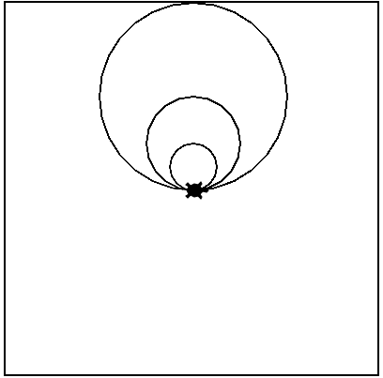
Changing a Variable’s Value
Code Output
Notes:
When we run this code, our output will be three circles, with radius values of 25, 50 and 100. Let’s look at using variables to write a Tracy program.

Slide 9
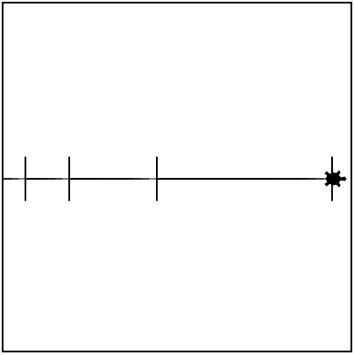
Example #1: Increasing Length
Write a program that has Tracy draw a line with hash marks at 25, 50, 100, and 200 pixels.
Notes:
In this example, we want Tracy to start at the left side of the screen and draw a horizontal line with hash marks at the 25, 50, 100, and 200 pixel positions.

Slide 10
Commands Learned this Lesson
Command | What does it do?
variable_name = value | Assigns a variable
Notes:
In this lesson, we learned how to assign and use variables. Refer to the example we went through to help you use variables to solve some Tracy challenges of your own!

